Slide 1
XTEA (eXtended TEA) Block Cipher
Kapakos Georgios: 03165

Slide 2
What is XTEA?
XTEA (eXtended TEA) is a symmetric block cipher algorithm designed for encryption and decryption of data. Here are key points about XTEA:
Block Size: Operates on fixed-size blocks of data, typically 64 bits (8 bytes).
Key Size: Uses a 128-bit key (16 bytes).
Rounds: The algorithm consists of multiple rounds (typically 64 rounds).
Operations: Each round involves bitwise XOR, addition, and bitwise shifts.
Key Expansion: The 128-bit key is expanded into 64 subkeys, which are used in the encryption and decryption rounds.
Security Features: XTEA is designed to provide improved security compared to its predecessor, TEA (Tiny Encryption Algorithm).
Compact Code: Known for its simplicity and compact code size, making it suitable for resource-constrained environments.
Open Design: XTEA is in the public domain, and its simplicity facilitates easy understanding and implementation.
Use Cases: While not widely used in mainstream cryptography, XTEA has found applications in embedded systems, wireless sensor networks, and other scenarios with limited resources.
Caution: XTEA, like any cryptographic algorithm, requires careful consideration of key management and usage to ensure security. While it provides a level of security, it may not meet the requirements of the most advanced cryptographic standards.
XTEA is not recommended for new cryptographic applications, as more modern and widely adopted algorithms, such as AES (Advanced Encryption Standard), are available and considered more secure.

Slide 3

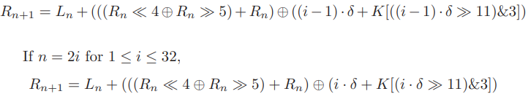
Algorithm for XTEA
XTEA is also a 64-round Feistel block cipher with 64-bit block size like TEA. Its 128-bit secret key K is (K[0], K[1], K[2], K[3]), too. Let (Ln, Rn) be the input of n-th round for 1 ≤ n ≤ 64. The output of n-th round is (Ln+1, Rn+1), and Ln+1 = Rn. If n = 2i − 1 for 1 ≤ i ≤ 32

Slide 4
Describing the XTEA circuit
XTEA circuit consists of the following modules:
xtea.sv(top module)
xtea_core.sv
The modules we use for the testbench are:
tb_xtea.sv(top module)
tb_xtea_core.sv

Slide 5
XTEA module
Inputs:
clk (Clock):
Clock input for the module, typically used to synchronize operations.
reset_n (Active-Low Reset):
Reset input, where a low signal (0) indicates a reset condition.
cs (Chip Select):
Control signal indicating whether the module is selected or not. When asserted (1), the module responds to the transactions.
we (Write Enable):
Control signal indicating whether the upcoming transaction is a write operation. If asserted (1), it signals a write operation.
address (Address):
An 8-bit wide input representing the address for memory-mapped operations. It indicates where the data should be read from or written to.
write_data (Write Data):
A 32-bit wide input representing the data to be written into the module. Relevant only when a write operation is asserted
Output:
1. read_data (Read Data):
A 32-bit wide output representing the data read from the module. This output is valid only when a read operation is performed.

Slide 6
XTEA core module
Inputs:
clk: Clock input.
reset_n: Active-low reset input.
encdec: Encryption/decryption control signal.
next: Next control signal
rounds: 6-bit input for specifying the number of rounds.
key: 128-bit key input.
block: 64-bit block input for encryption/decryption.
Outputs:
result: 64-bit result output after encryption/decryption
ready: Ready status output.

Slide 7
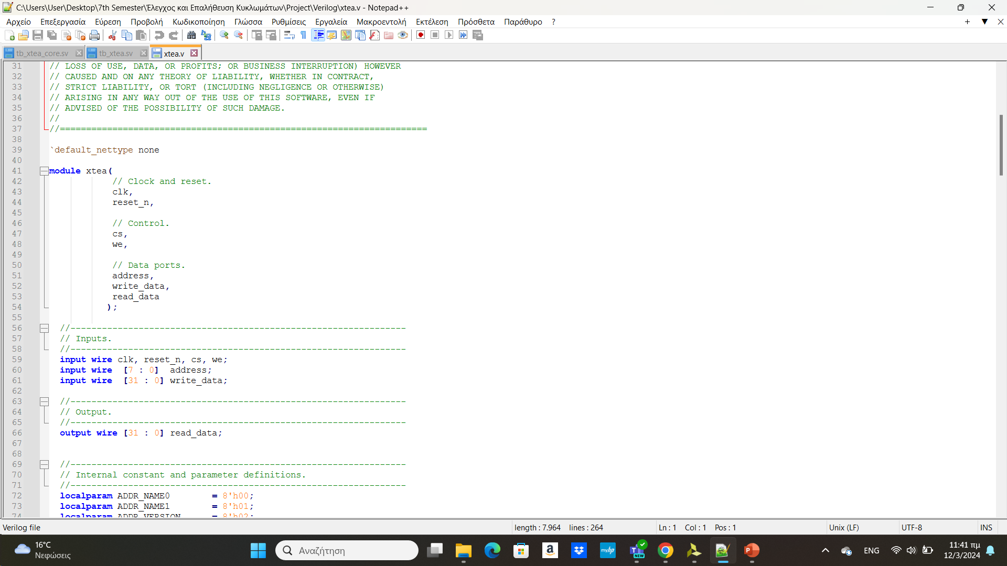
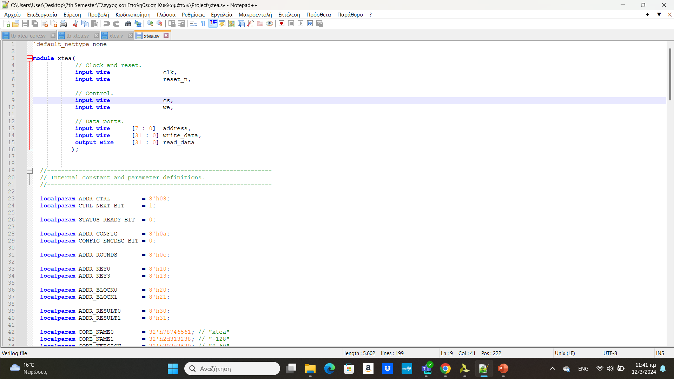
Improvements from Verilog to SystemVerilog
Inputs/outputs when we declare a module
Verilog: SystemVerilog:
In systemverilog we can declare inside the module its type and if it is an input or an output.

Slide 8
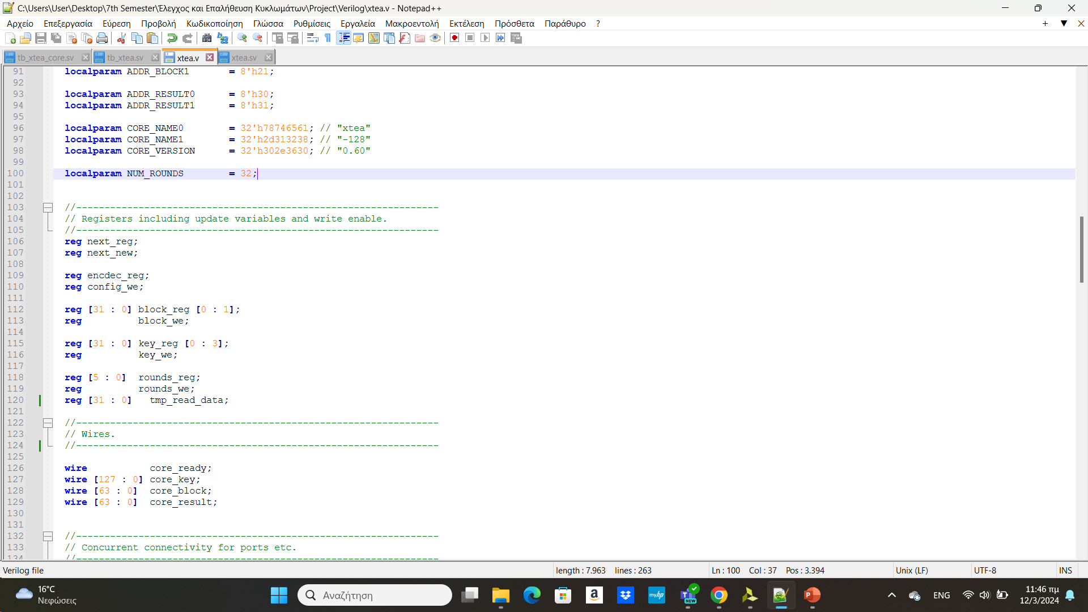
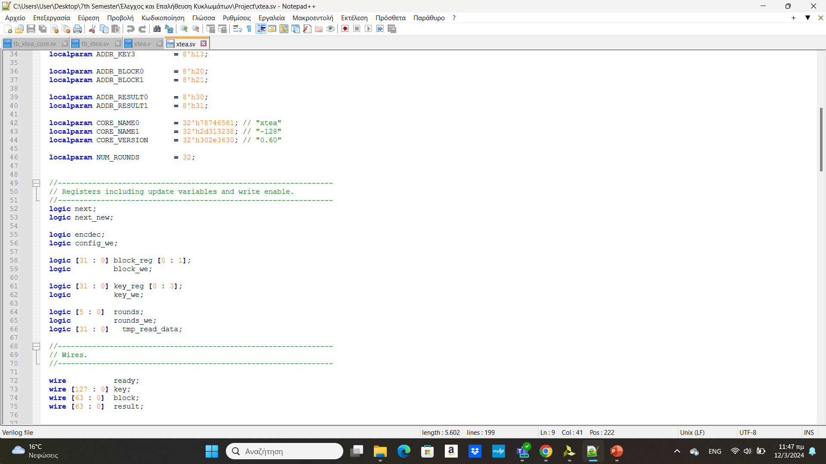
Logic instead of regs
Verilog SystemVerilog
Logic in SystemVerilog can provide a more precise and consistent type for representing logic value. It is intended to improve clarity and avoid some of the ambiguities associated with reg in Verilog.

Slide 9
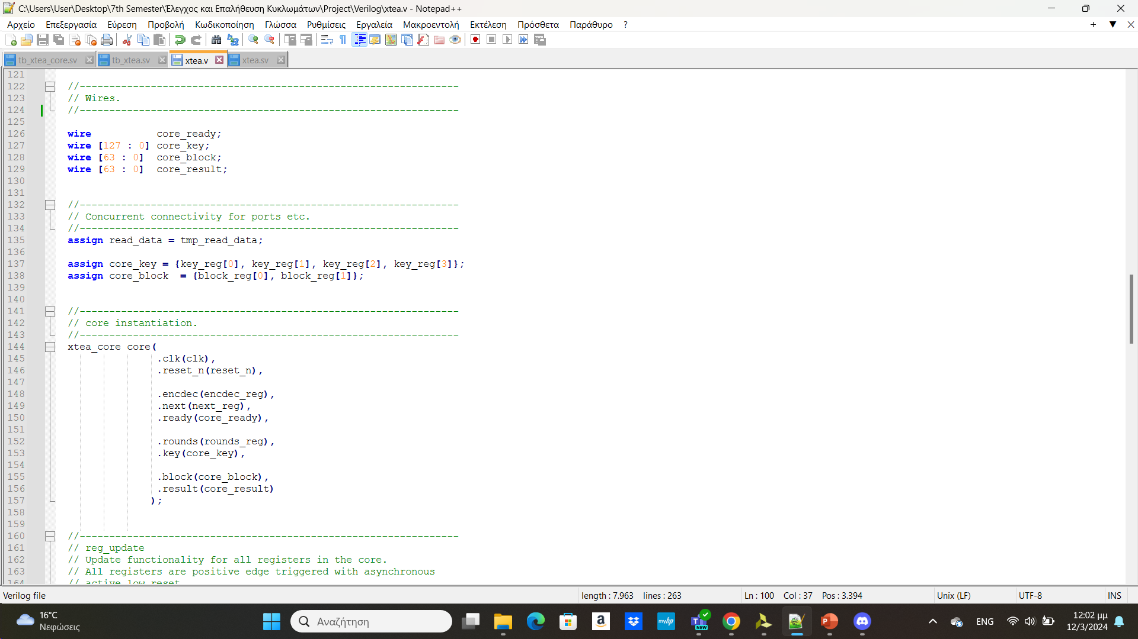
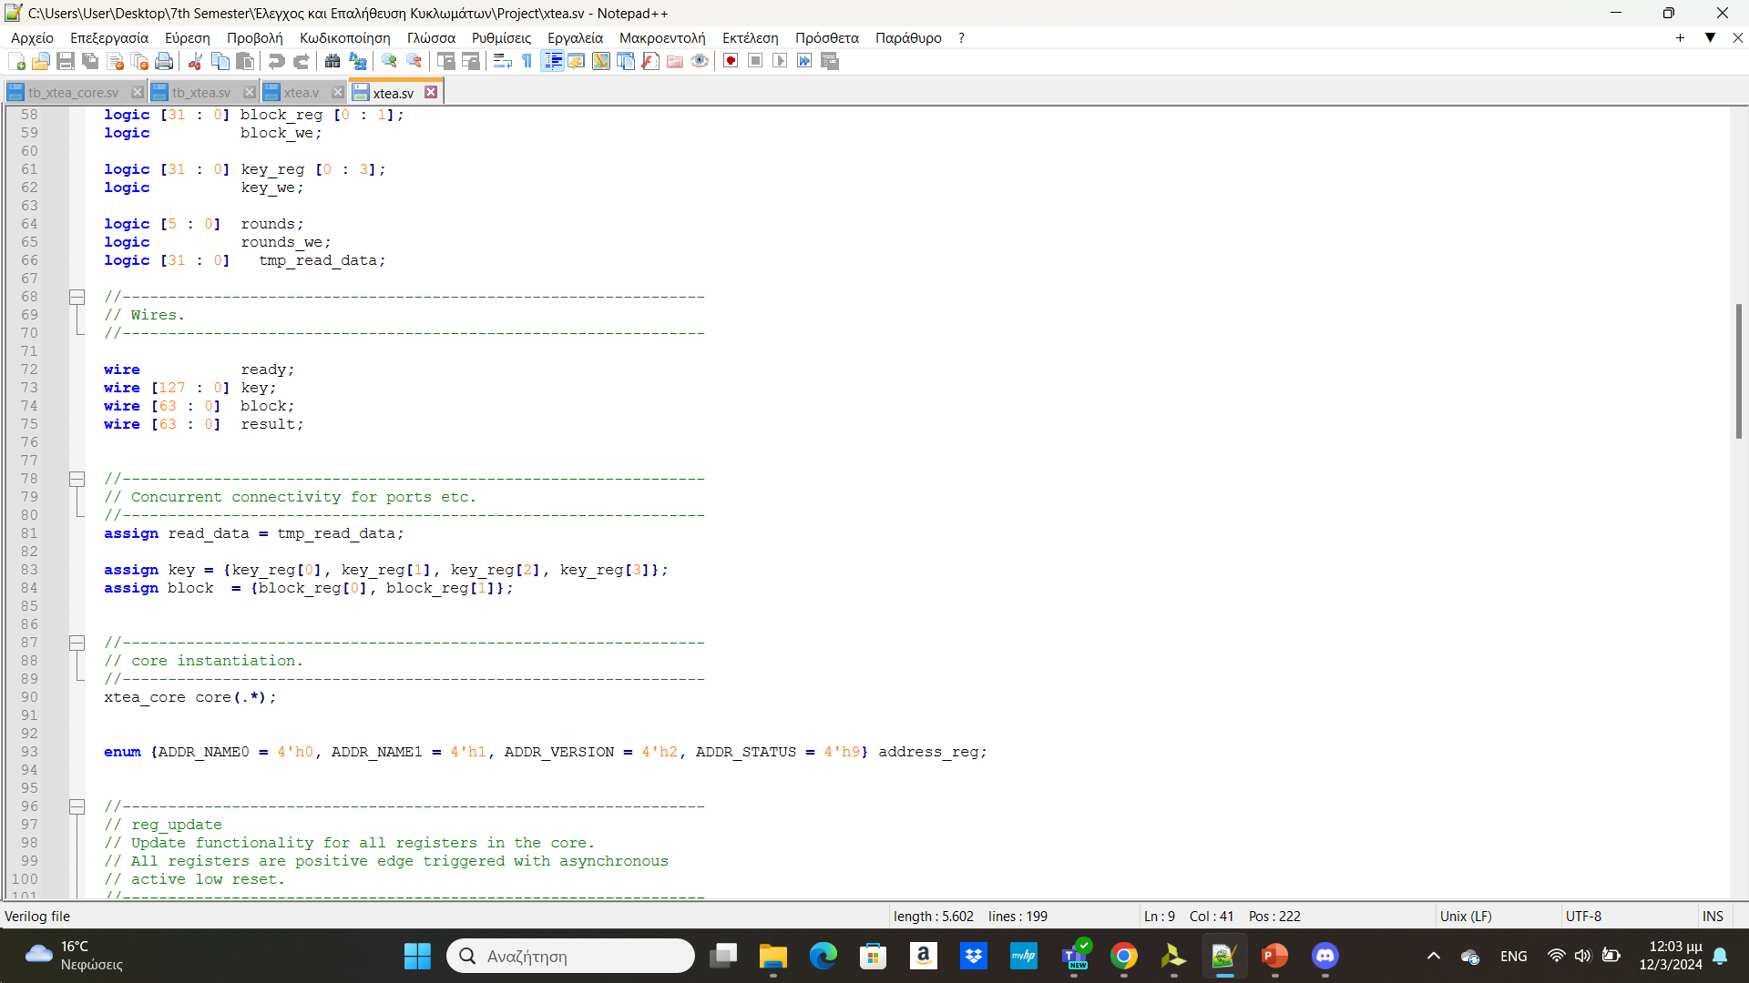
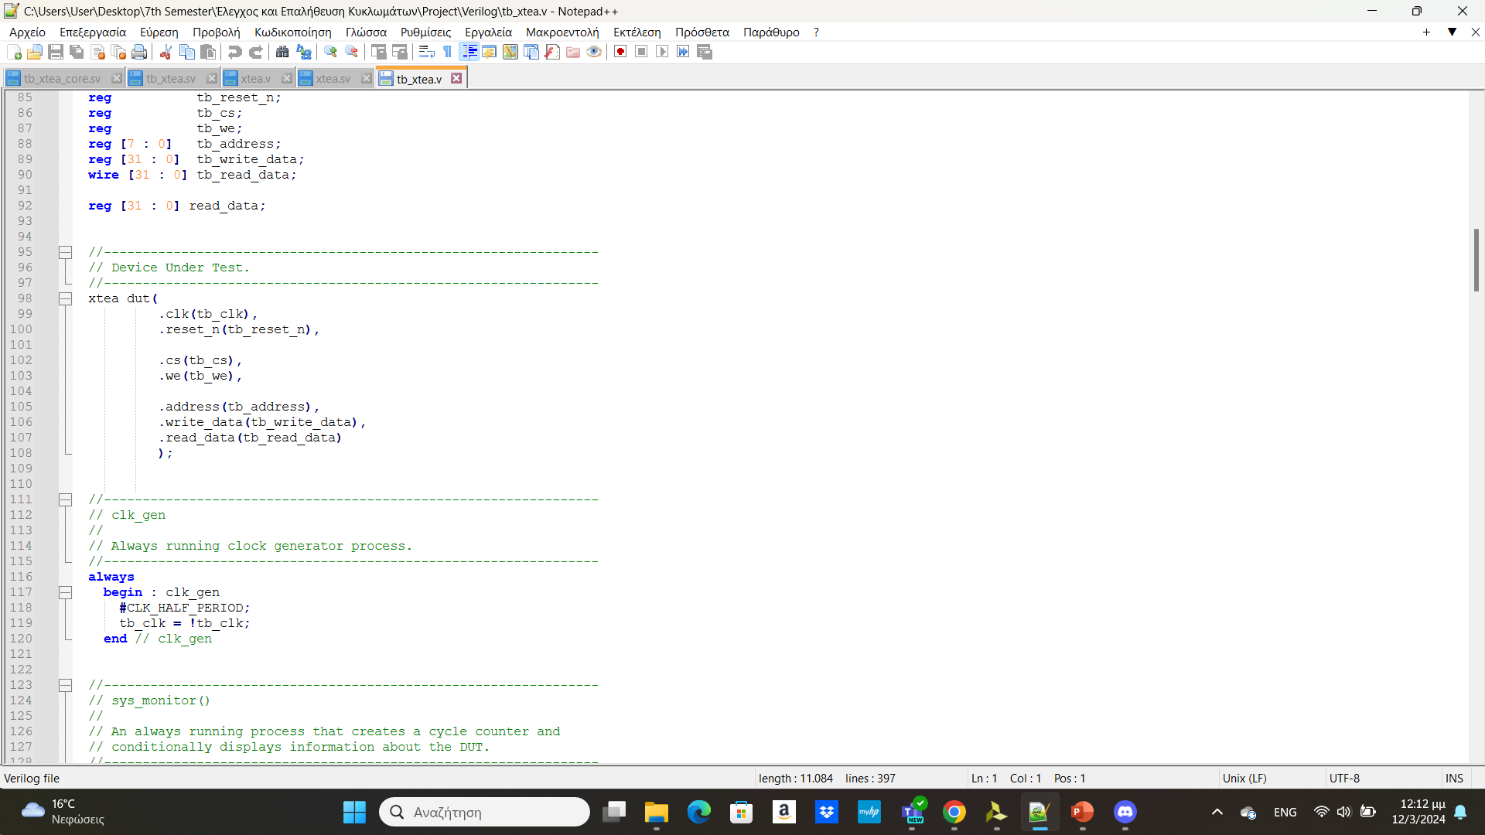
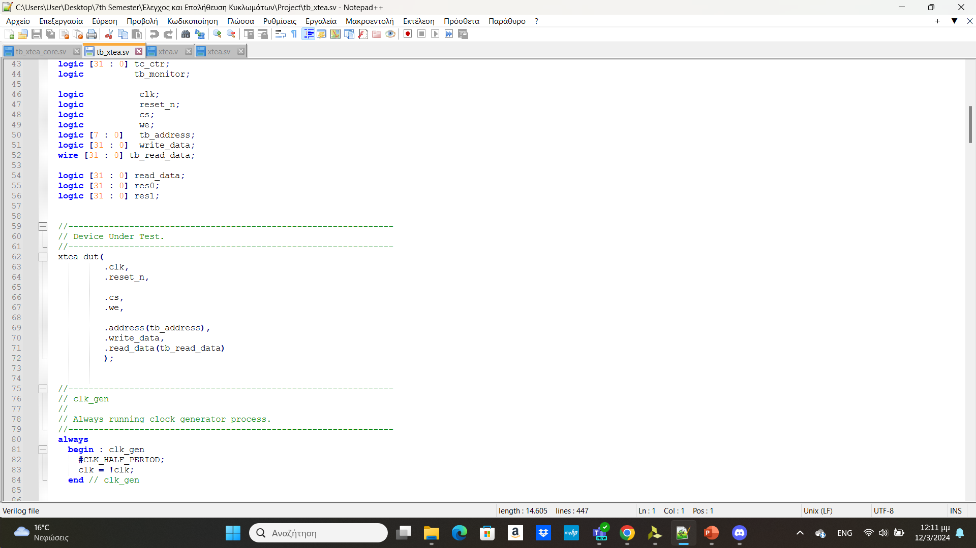
Instantiations during declaration
Verilog SystemVerilog
In SystemVerilog we use (.*) inside the module if all the variable names match the inputs and outputs of the module, or if not all the I/Os do not match the variable names then we cannot use (.*), but if some match the variable names we can use .<name>, instead of .<name>(<name>). In Verilog we have to declare inputs and outputs one by one, declaring the next to the I/Os the variable names.

Slide 10
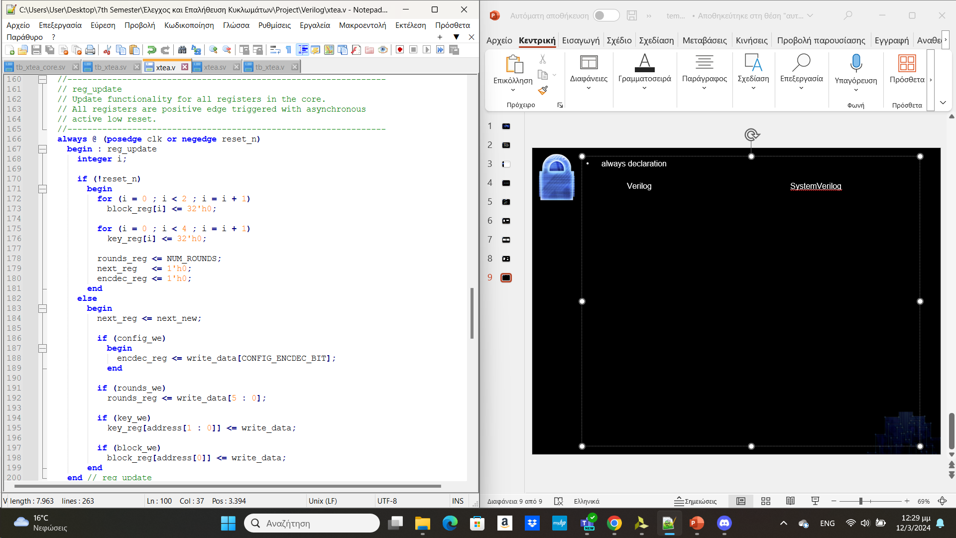
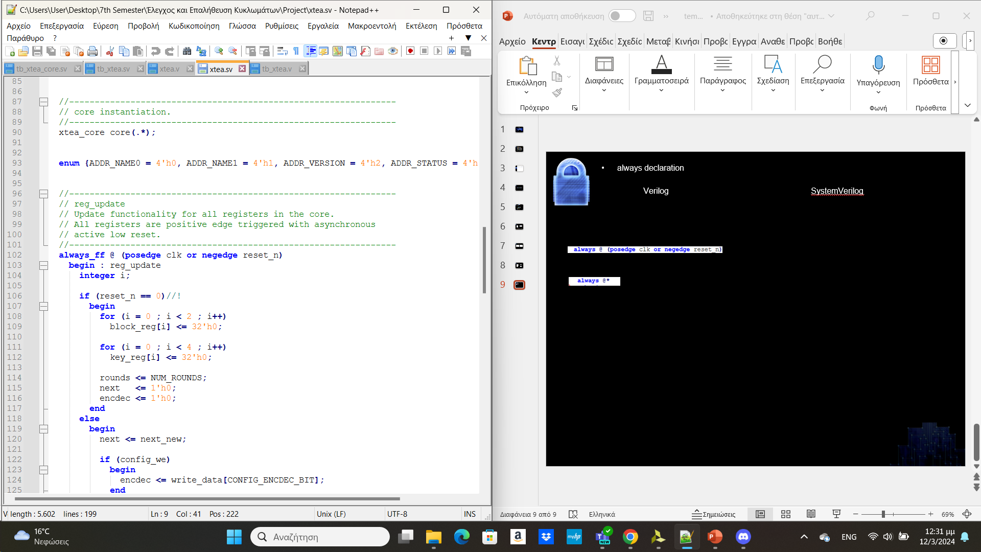
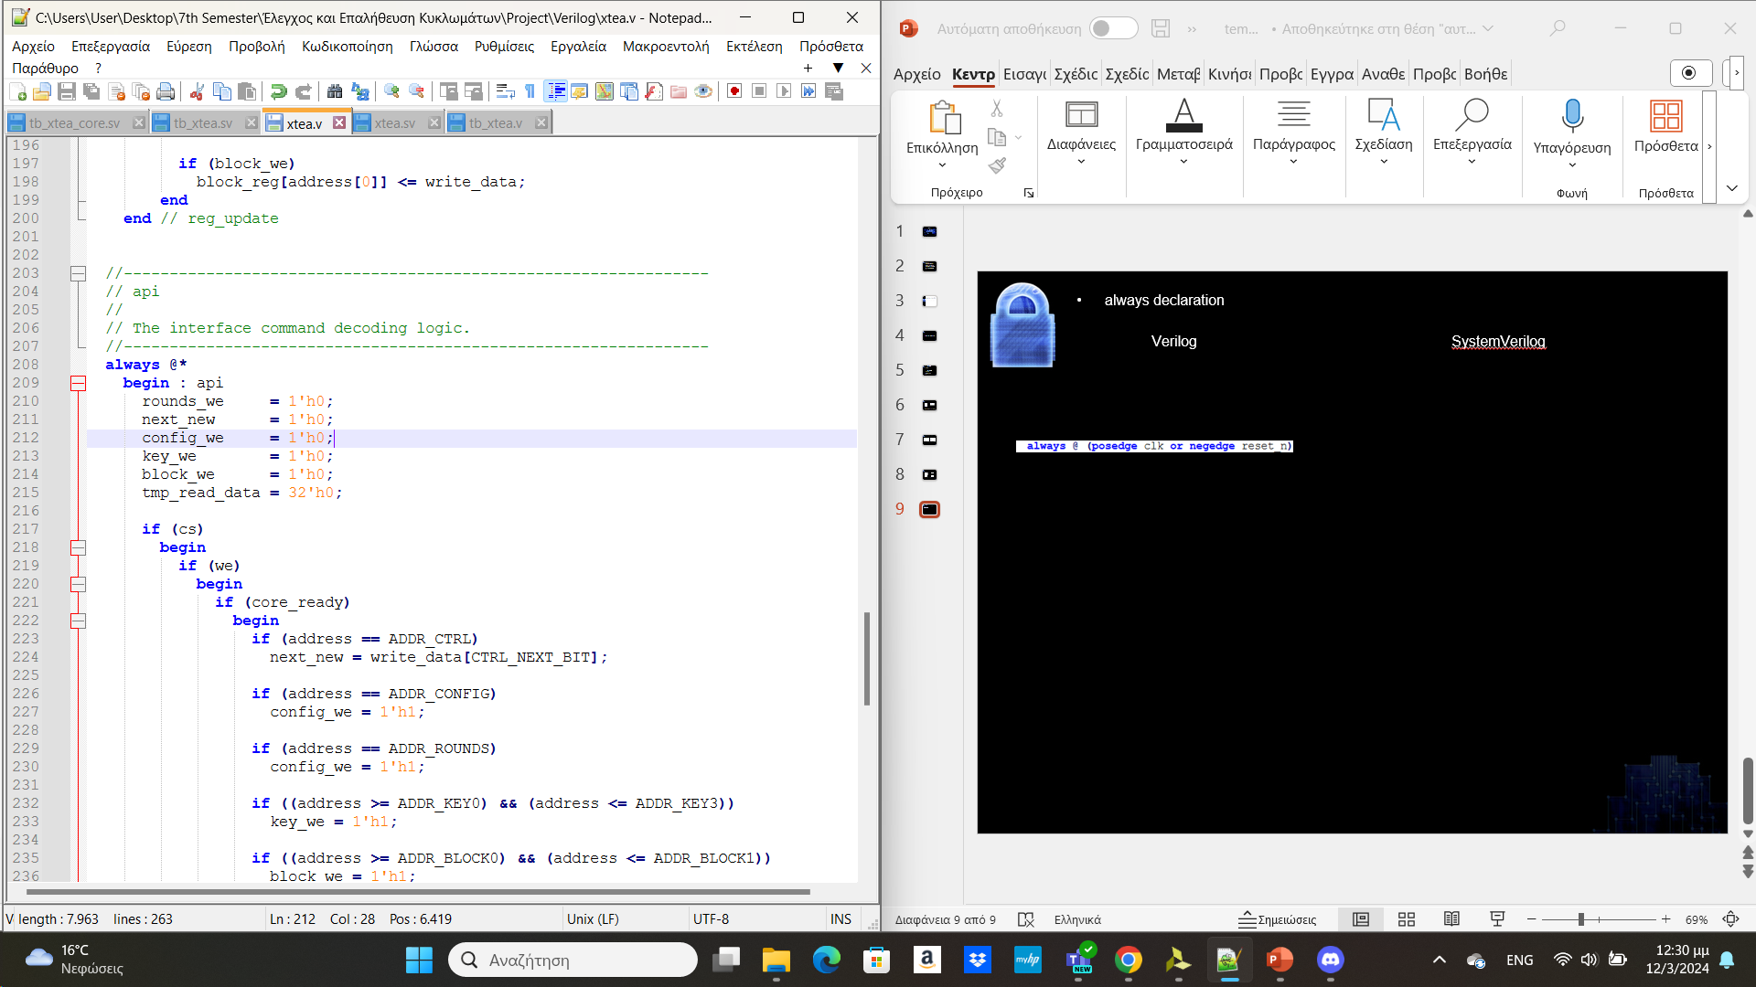
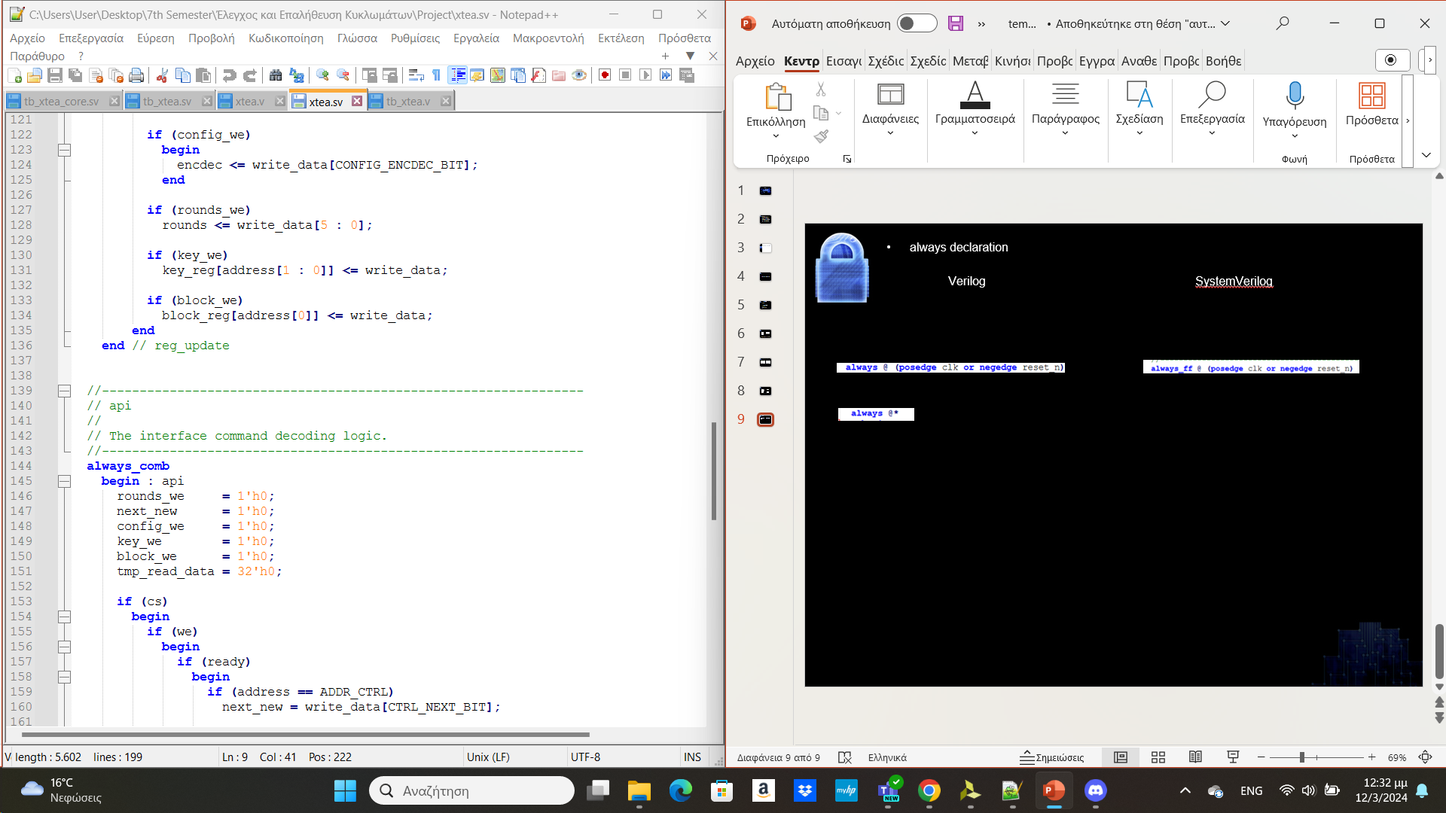
always declaration
Verilog SystemVerilog
Procedural always blocks become always_comb and always_ff is used to describe sequential always blocks, always_ff and always_comb provide a guarantee that latches will not be created an improvement in SystemVerilog that doesn’t exist in Verilog.

Slide 11
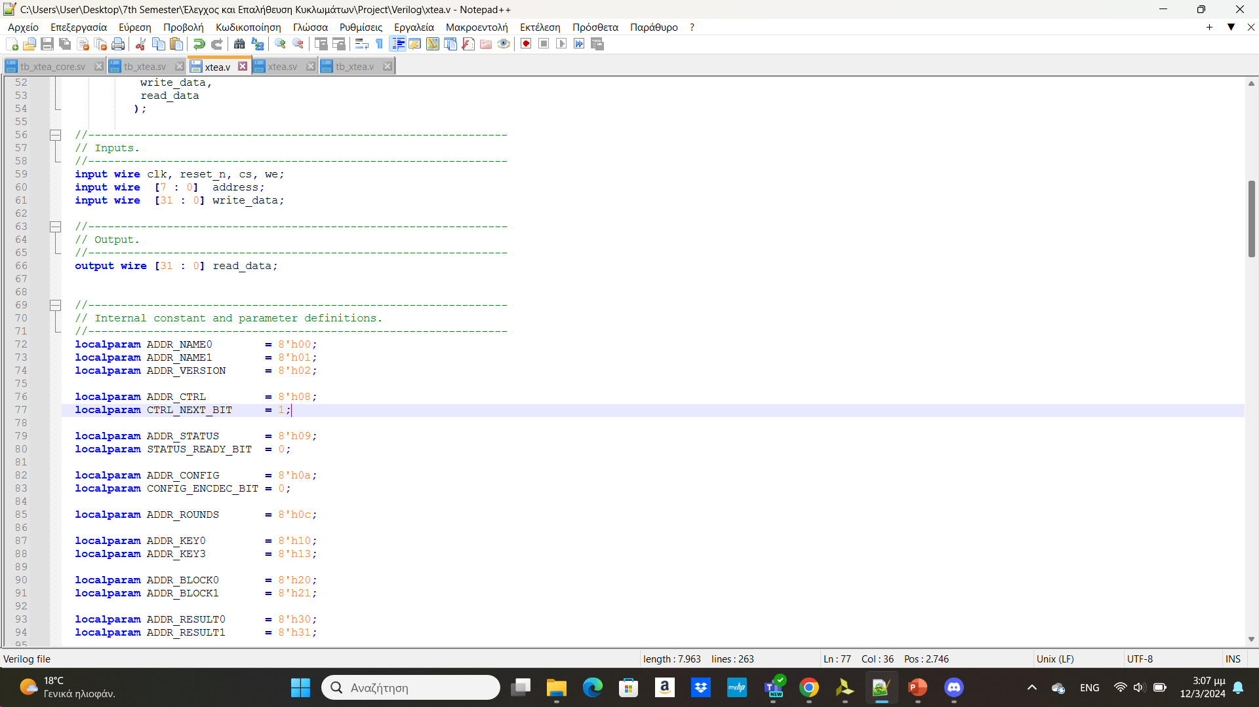
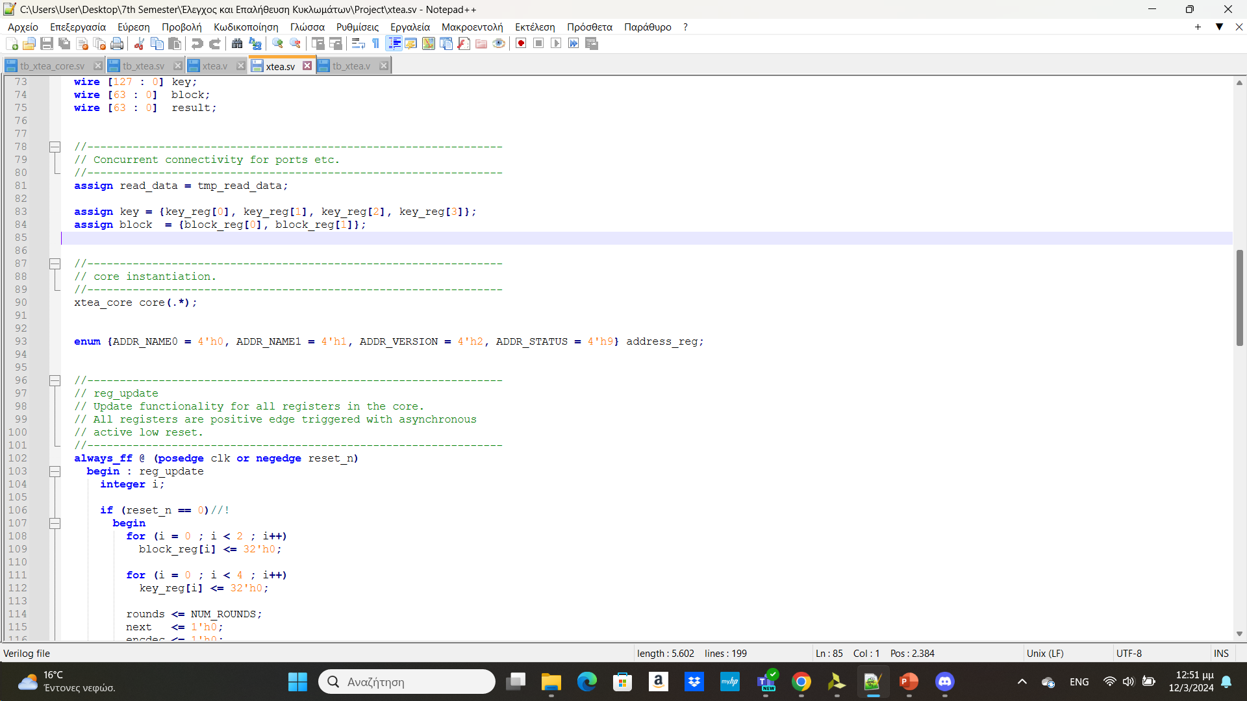
FSM Declaration
Verilog SystemVerilog
SystemVerilog introduces enumerations, which allow you to define a set of named values. Enumerations can be used to represent states and make the FSM code more readable and self-explanatory. Instead Verilog is using parameters to refer to those sets.

Slide 12
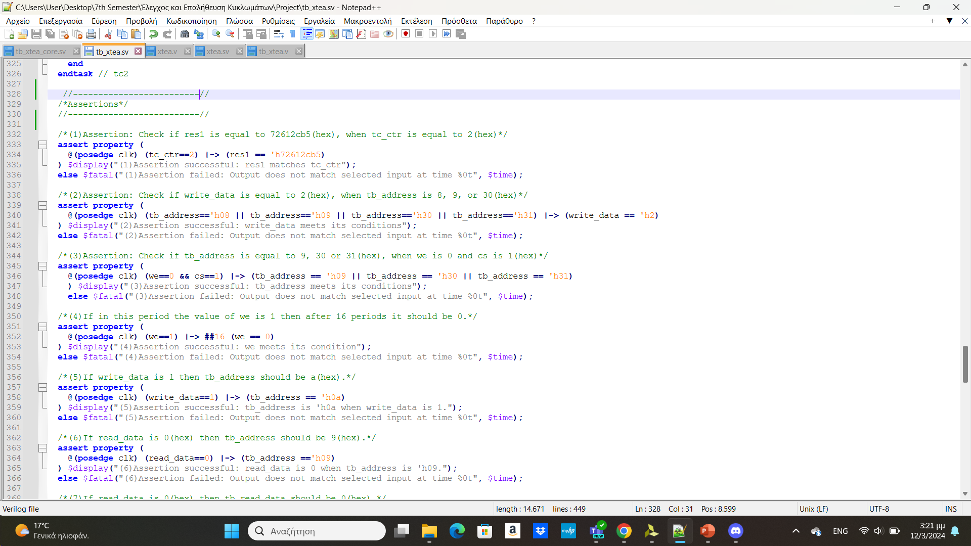
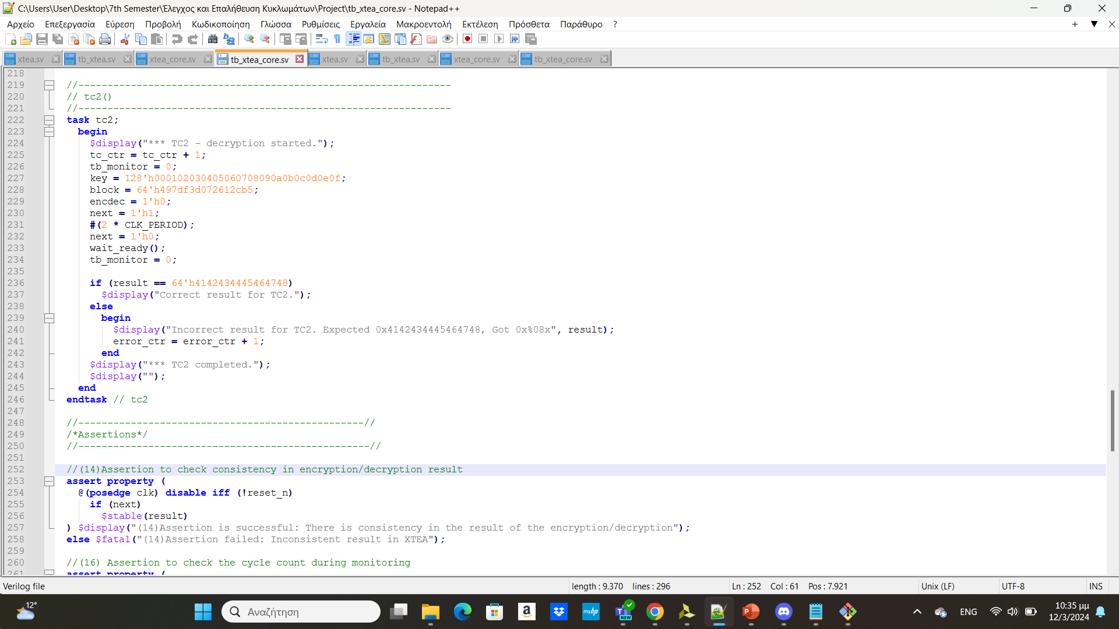
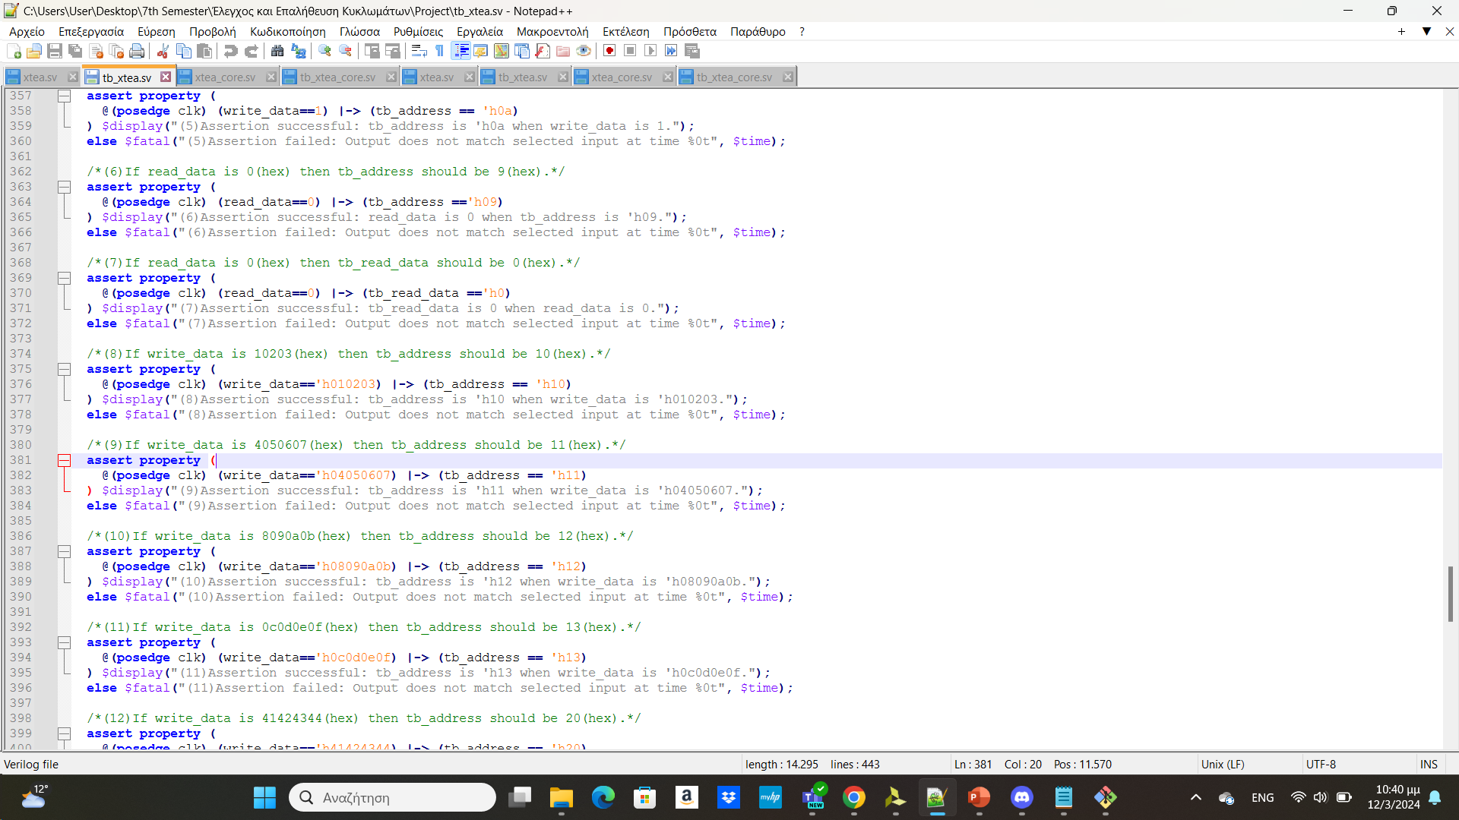
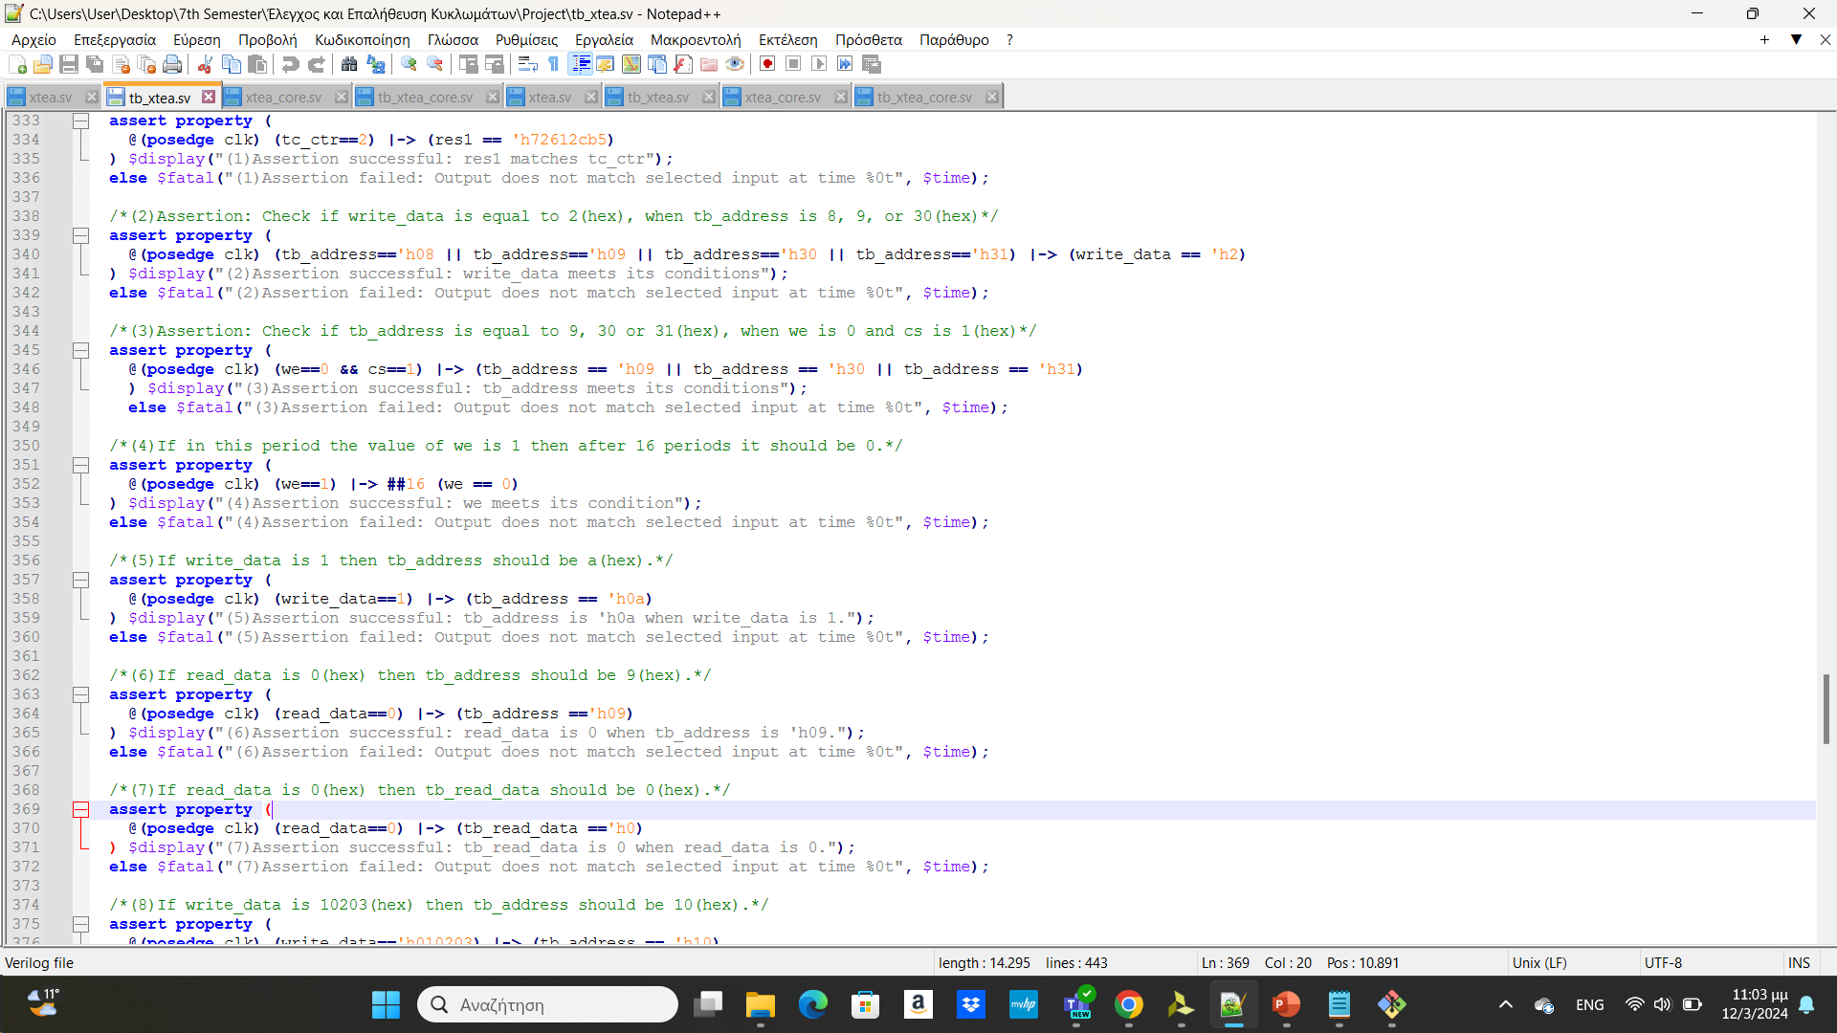
Assertions
In the above assertion we expect tb_address to be 9(hexadecimal) when read_data is zero.
In the above assertion we check the consistency in the encryption/decryption result, by checking if result is stable.
Checking if tb_read_data receives the value 0, when read_data has the same value.
Check if the value of we changes after 16 rounds from 1 to 0.

Slide 13

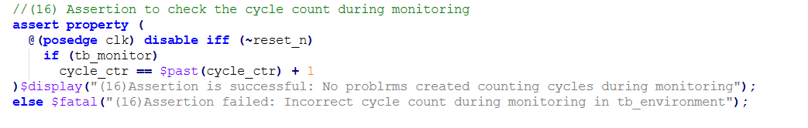
Assertions
In the above assertion we check the cycle count in monitoring if it is being counted right.
Assertions in SystemVerilog are essential tools for automated verification, error detection, and debugging in digital designs. They express design properties and conditions, helping ensure correct functionality, aiding in debugging, and serving as documentation for design intent. Assertions contribute to a more robust verification process, providing early feedback on design correctness and facilitating efficient error diagnosis.
The |-> (non-blocking implication) operator in SystemVerilog assertions is used to express an implication relationship. It is a form of temporal logic operator that indicates a logical implication over time. The assertion following |-> is expected to become true if the conditions before |-> are true in some future simulation cycle.
##n is used to check a value after n rounds have passed.

Slide 14
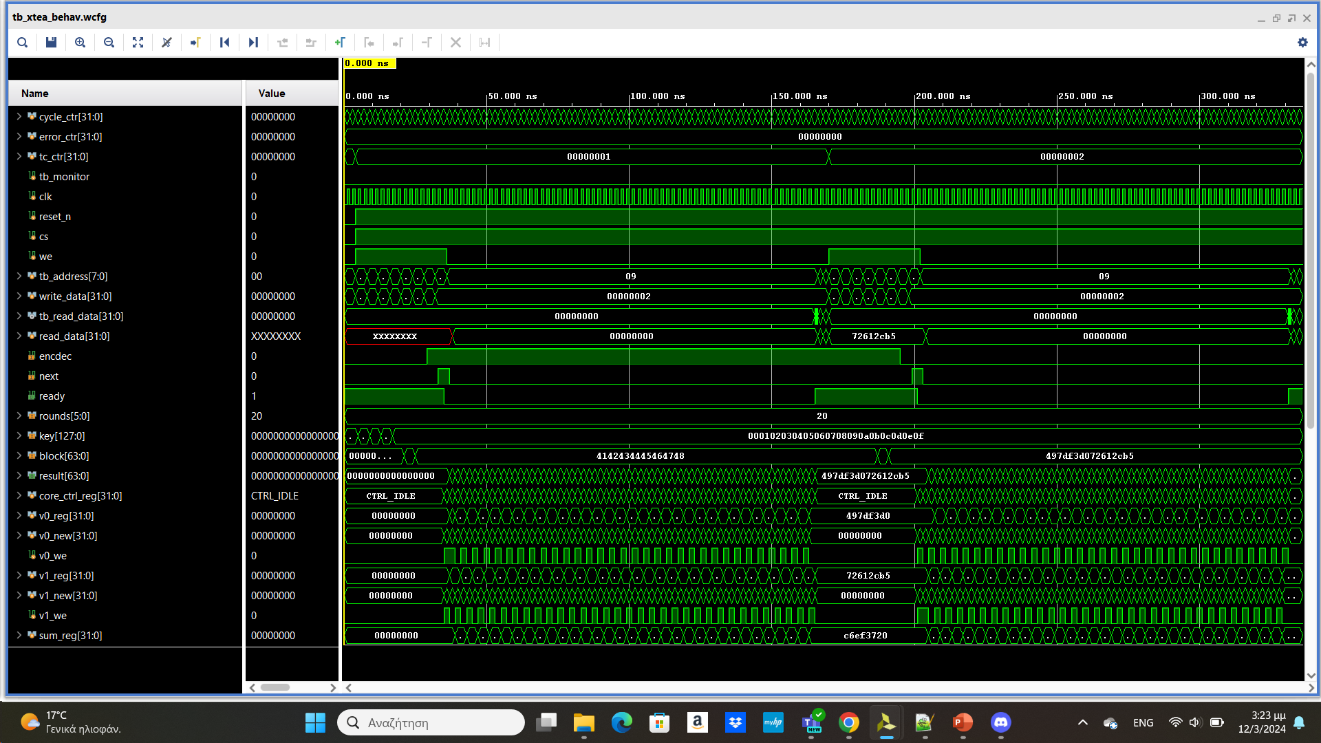
Waveforms

Slide 15

Thank you for your attention

